Slide 1

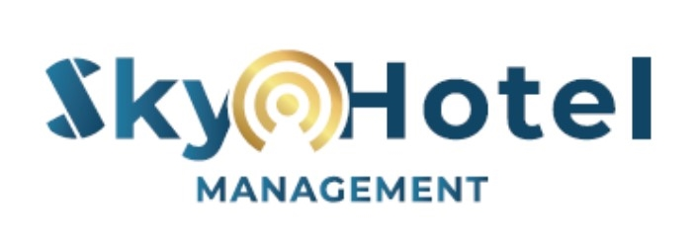



INDEPENDENT HOTEL MANAGEMENT
THIRD PARTY OPERATOR (TPO)
+66 848794105 / 818915494
info@beaconskyhospitality.com
www.beaconskyhospitality.com

Slide 2


SKY Hotel Management
SKY HOTEL Management (SHM) offers Independent Hotel and Resort management services with offices in Bangkok and Phuket. The services are in the form of a Third Party Operator (“TPO”) whereby SHM manages a hotel / resort property for an owning company, while the property has a franchise, and brand license agreement with an international hotel brand. Often called a White Label or an Independent Hotel Management Company. The TPO management may also be provided to unbranded or owner’s branded properties. Sky Hotel Management is a subsidiary of “Beacon Sky Hospitality”, which is a hospitality consultancy firm registered in Bangkok, Thailand
www.beaconskyhospitality.com
© 2020 Marley’s all rights reserved

Slide 3

Operating company
“Sky Hotel Management”
Property Owning Company
Hotel
Management
Hotel/Resort/
Estate/Condotel
Franchise
Agreement
International
Hotel Brand

Slide 4
Structure
The Owning company engages in a Franchise / License agreement with an International Hotel Brand at a franchise fee, which includes :
License agreement
Marketing and reservation fee , plus a distribution and reservation system and marketing platform of the brand.
Alternatively the owning company has it’s own private brand.
The Owning company engages with SHM in a hotel management agreement for managing the property for a management fee.
The Owning company employs the team and all employees by contract and the team is consequently managed by SHM, with the General Manager jointly appointed by the owning company and SHM.
All revenues, expenses and profits remain with the owning company.

Slide 5
Third Party Operator Agreement
SHM will manage the hotel/resort/condohotel; all employees and all operational functions
These management services by SHM include the following :
Managing all departments and overall operations.
Manage Finance, Marketing, Human Resources activities
Set the correct manning guide
Ensuring SOPs are implemented and adhered to
Post COVID implementing CLEAN Management, scaled down organizations structure, new outsourcing methodology, new F&B concepts and reduced cost of operations

Slide 6
Why TPO
Lower cost than Hotel Management Agreement (HMA) with more attractive terms
Still benefit from International brand marketing & distribution and loyalty programs
Leaner and more flexible property management
Outsourcing of key departments : Sales, Marketing, Finance – all optional
Market driven revenue management
Owner has option to maintain and or grow it’s own brand
TPO have owner’s interest more in mind than Brand Operator

Slide 7
Benefits
of a TPO
SHM offers International Hotel management skills
Flexible brand standards
Owner retains control
Owner is not involved in day to day operations
Commercial Terms are more attractive & less binding
Owner has direct interaction with hotel management company as required

Slide 8
Thank You

